Slide 1
CSE 246: Algorithms
Analysis of Algorithms

Slide 2
Asymptotic Analysis using Asymptotic Notation
Approximate analysis
Machine specific execution time
Based on input how the execution time varies (e.g, loop)

Slide 3
Asymptotic Notation
Θ (Theta notation)
O (Big O notation): Most popular notation
Ω (Omega notation)

Slide 4

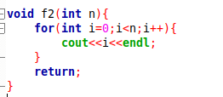
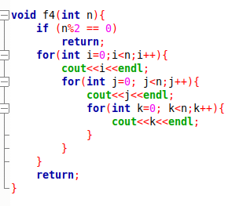
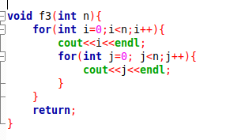
O (Big O notation)
A Solution’s upper bound

Slide 5
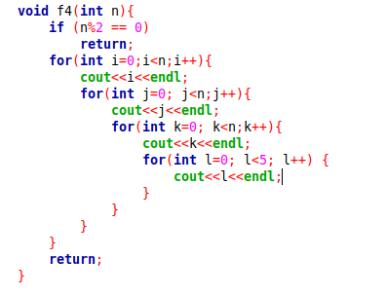
O (Big O notation)
Definition: Let g and f be functions from the set of natural numbers to itself. The function f is said to be O(g) , if there is a constant c > 0 and a natural number n₀ such that f (n) ≤ c * g(n) for all n >= n₀ .
O(g(n)) = { f(n): there exist positive constants c and
n₀ such that 0 <= f(n) <= c*g(n) for
all n >= n₀}

Slide 6
O (Big O notation)
Constant Multiplication: If f(n) = c * k(n), then O(f(n)) = O(k(n)) ; where c is a nonzero constant.
Polynomial Function: If f(n) = a₀ + a₁.n + a₂.n² + —- + a_{m}.n^{m}, then O(f(n)) = O(n^{m}).
Summation Function: If f(n) = f₁(n) + f₂(n) + —- + f_{m}(n) and f_{i}(n)≤f_{i+1}(n) ∀ i=1, 2,..., m, then O(f(n)) = O(max(f₁(n), f₂(n), … , f_{m}(n))).
Logarithmic Function: If f(n) = log_{a}n and g(n)=log_{b}n, then O(f(n))=O(g(n))

Slide 7
Ω (Omega Notation)
Lower Bound Calculation
Ω (g(n)) = { f(n): there exist positive constants c and n₀ such that 0 <= c*g(n) <= f(n) for all n >= n₀}.

Slide 8
Θ (Theta notation)
Merges Upper bound and lower bound
Θ(g(n)) = {f(n): there exist positive constants c1, c2 and n₀ such that 0 <= c1*g(n) <= f(n) <= c2*g(n) for all n >= n₀}

Slide 9
Sources
https://www.geeksforgeeks.org/analysis-of-algorithms-set-1-asymptotic-analysis/

Slide 10
Thank You

